Slide 1
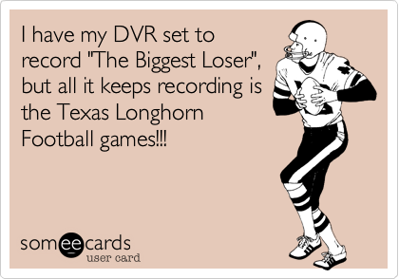
Day 8- The Need for Addressing
Unit 1- Lesson 9 & 10

Slide 2
Grade Discuss Test
Quiz Today

Slide 3
Vocabulary
IP Address- A number assigned to any item that is connected the internet
Packets- Small chunks of information that have been carefully formed from larger chunks of information
A typical packet contains perhaps 1,000 or 1,500 bytes

Slide 4
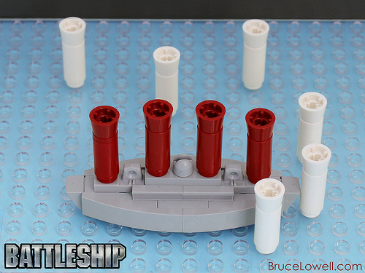
Broadcast Battleship Set-Up
Who has played the classic game of Battleship
We will start by playing a game that simulates some issues that arise when constructing the internet.
We will play a crazy game of Battleship where instead of playing against one other person you will play multiple games against multiple other people simultaneously – We call this “Broadcast Battleship”
In our version today, you will play in groups of 3 (4 is OK)
To make it easier to track, we’ve also simplified the playing board to just a 3x3 grid (instead of the classic 10x10)
And we’ll just play with paper and pencil.

Slide 5
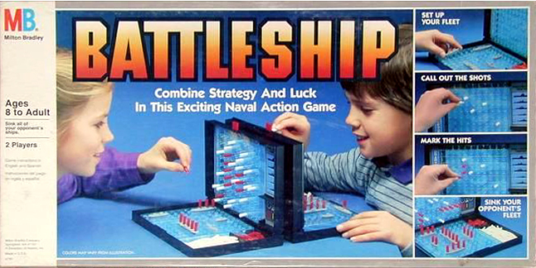
Broadcast Battleship Rules
Activity Guide - Broadcast Battleship Rules
Activity Guide - Broadcast Battleship Game Board
Write in the names of your partners on the lines below.
Shade in boxes for your ships’ locations in the “My board” sections. Ships are 2 units long and are either horizontal/vertical, no diagonals.
You can have a different ship placement for each opponent.
Don’t show your board to your opponents! Record each hit with an “X” and miss with an “O.”

Slide 6
Finish Code.org Lesson 9

Slide 7
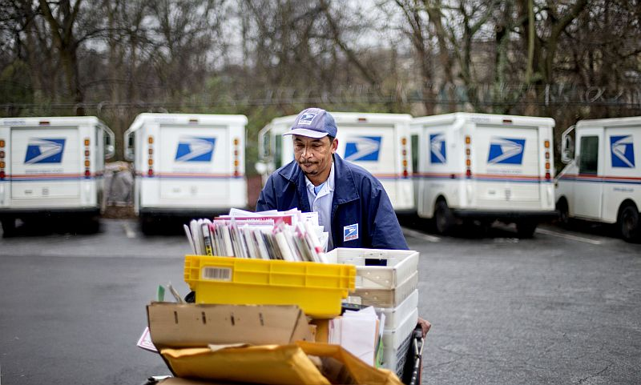
Discussion
Imagine you were going to send a letter to a friend living in another state. What are some of the steps you imagine your letter would have to take through the different parts of the postal system.

Slide 8
Code.org Lesson 10
A router is a computer designed to receive and redirect packets of information based upon the addressing information (e.g. an IP address) contained in the packet.
Routers will either deliver a packet to its final destination or forward it to one of several other routers it is connected to.
By monitoring current network conditions, a router can determine which of these will allow the packet to reach its destination fastest.
There will often be redundant paths between two locations on the Internet, and so if one path is experiencing traffic or otherwise out of service, additional paths will be available.
This redundancy makes the Internet more reliable and also helps the Internet to scale, accommodating new users (and routers!) as they are connected to the system.

Slide 9
Code.org Lesson 10
Routers and Redundancy Activity
Internet Simulator- 4th Time!

Slide 10
How the Internet Works in 5 Minutes

Slide 11
Finish code.org
Finish Code.org Lesson 10

Slide 12
Lesson 9- Review
Addressing on the Internet Simulator
Developing Protocols

Slide 13
Lesson 10- Review
Benefits of redundancy in a routed system, to provide many paths between users of the network.
Routed messages aren’t seen by all users, but they can still be seen by owners of the router.
If you control all the routers, you entirely control the way messages travel through the network, and additionally can see all the traffic.

Slide 14
Journal Due Again Soon
Unit 1 Test Coming Soon!

